Slide 1


EcoTrack
Sustainable Room Energy Monitoring Project
By Ruxandra Burian, Zichen Jing (Nancy), Jiwoo Lee, Afra Alhammadi, Renata Espinosa
by Ruxandra Burian, Zichen Jing (Nancy), Jiwoo Lee, Afra Alhammadi, Renata Espinosa

Slide 2
General Structure
Start → detect humidity, temperature, accelerometer → data logged
Case 1: Window open/close
Humidity increase beyond threshold → data recorded → LED red light & notification to phone
Case 2: Thermostat on/off
Temperature starts to decrease and plateau → data recorded for the duration → LED red light & notification to phone
Case 3: Light on/off
Accelerometer detects movement in switch (switch 1 and 2) → data recorded for the duration → LED red light & notification to phone

Slide 3
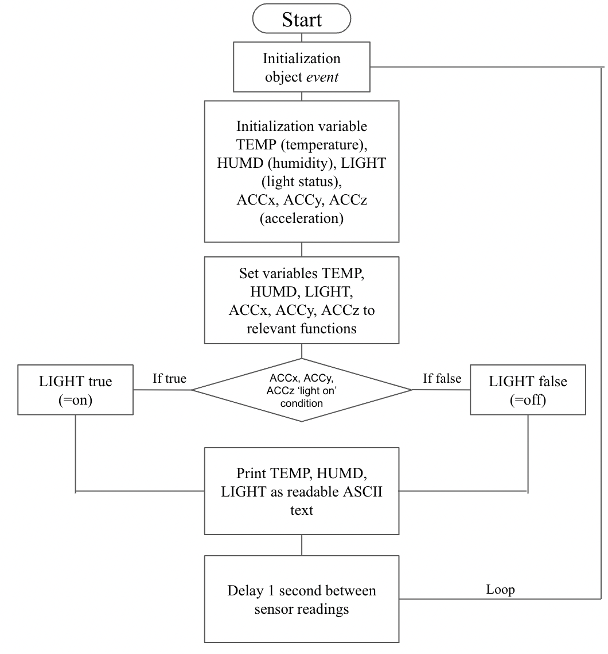
Walkthrough
Project detects room conditions using sensors. This happens continuously even before user prompts.
User wishes to track their energy usage/habitability of room.
The system provides data by uploading information to a website accessible to the user’s phone.
When the set environmental conditions of the room have not been met for a determined period of time, the LED of the object will turn red.

Slide 4
Pseudocode (libraries & object creation)
Sensors used:
BME280 - Humidity, Temperature
LSM6DS3 - Accelerometer
Include M5stickC library
Include wire library for I2C communication
Include Adafruit sensor library
Include Adafruit BME280 library for temperature and humidity sensor
Include Adafruit LSM6DS3Sensor library for accelerometer
Declare global variable of BME280 sensor address (0x__)
Create BME280 object for temperature and humidity sensor
Create LSM6DS3Sensor object for accelerometer

Slide 5
Declare void function SETUP to initialize I2C communication
Start serial communication between board and device with corresponding baud rate
Initialize M5StickC through M5.begin()
Initialize I2C communication through Wire.begin()
Set up LED strip through FastLED.addLeds
Set LED brightness
If BME does not begin in BME280_ADDRESS
Print “Could not find a valid BME280 sensor, check wiring”
Repeat while true
If accel does not begin
Print “Could not find a valid LSM6DS3 Sensor, check wiring”
Repeat while true
Setter function to set appropriate accelerometer range
In void function LOOP
Set LED color (array 0 to green)
Show LED color
Declare sensors_event_t object event, read sensor event from sensors
Declare float variable TEMP, set to function bme.readTemperature()
Declare float variable HUMD, set to function bme.readHumidity()
Read temperature and humidity from BME280 sensor
Get acceleration data from accelerometer event by reference
Declare float variable ACCx and set to function event.acceleration.x
Declare float variable ACCy and set to function event.acceleration.y
Declare float variable ACCz and set to function event.acceleration.z
Declare bool variable LIGHT
If ACCx, ACCy, and ACCz in ‘light switch on’ condition,
Assign true to LIGHT
Else
Assign false to LIGHT
If LIGHT is true, TEMP is below condition, HUMD is above condition
Set LED color to red
Show LED color
Print temperature data to the serial port as human-readable ASCII text
Print humidity data
Print state of LIGHT
Delay of 1 second between sensor readings

Slide 6
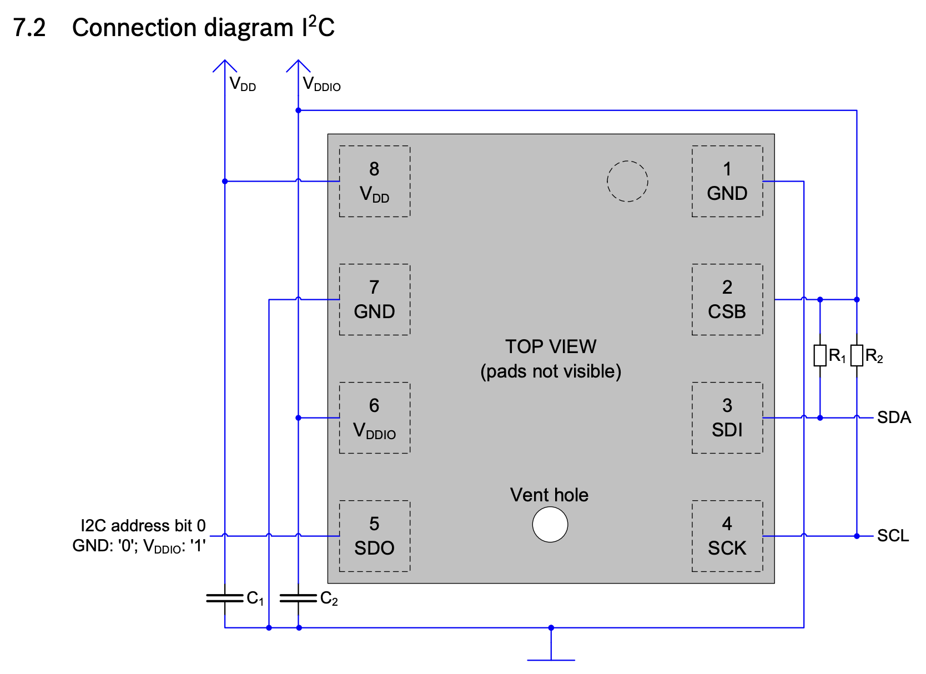
Datasheets used for circuit design
BME280

Slide 7
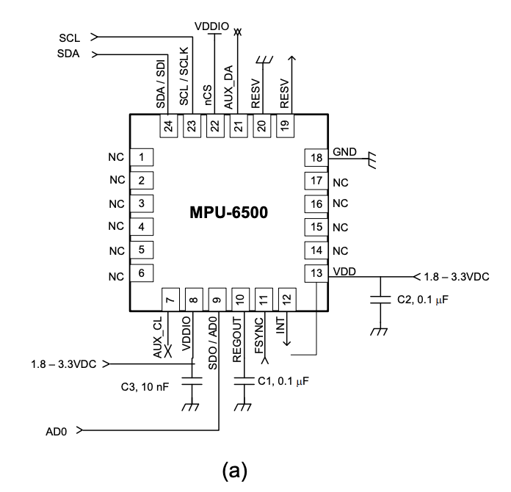
Datasheets used for circuit design
MPU-6500

Slide 8
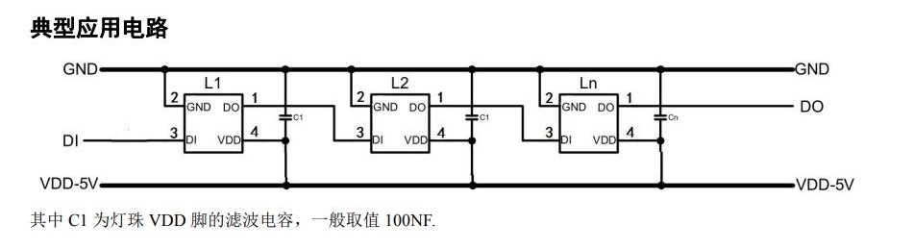
Datasheets used for circuit design
LED WS2812C

Slide 9
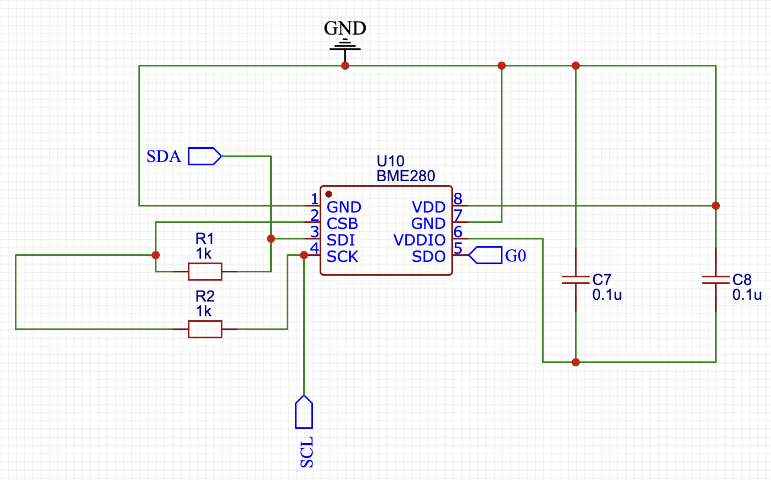
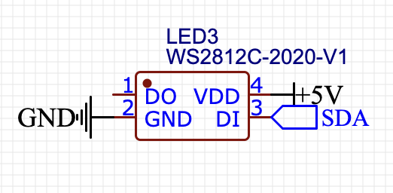
Initial Circuit Design
BME280
LED WS2812C

Slide 10
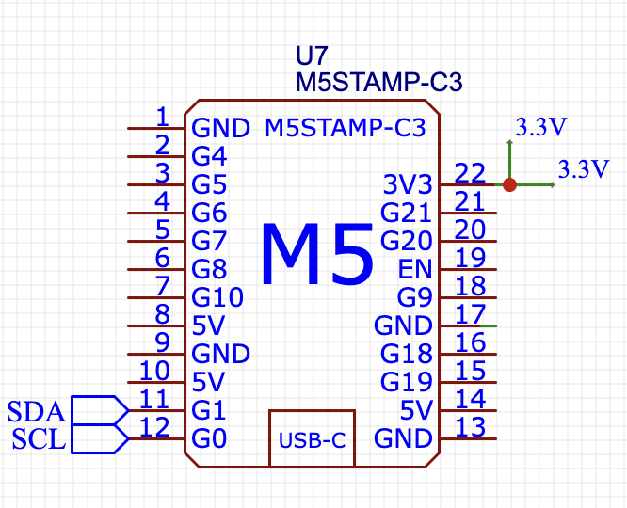
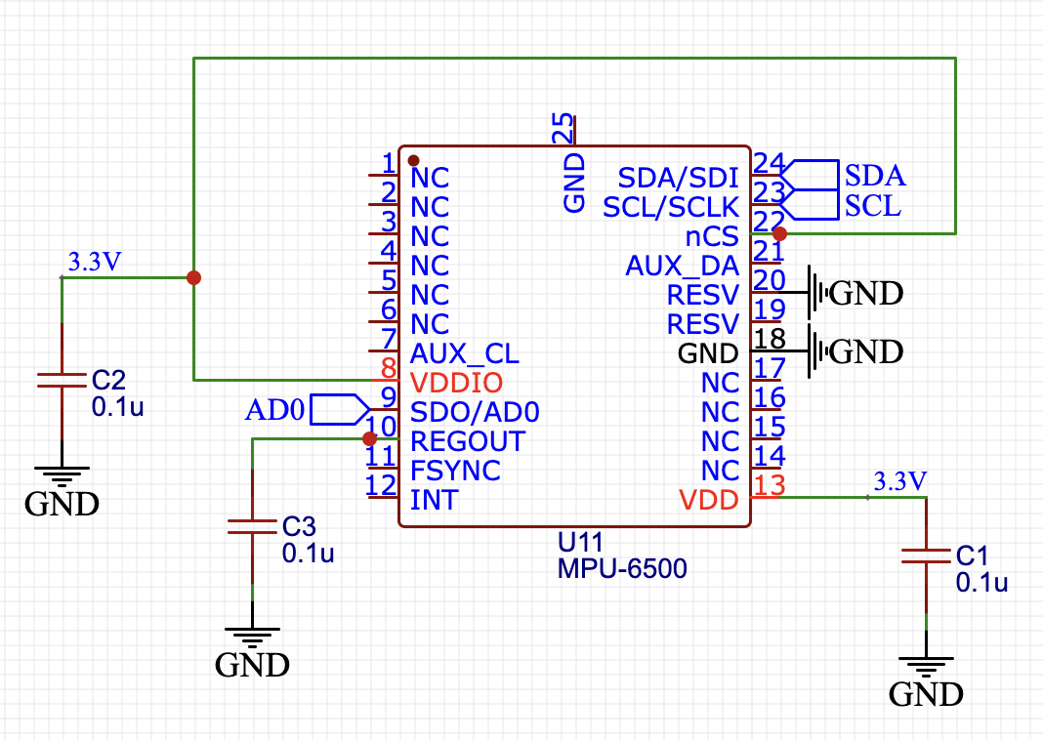
Initial Circuit Design
M5 Stamp (undone)
MPU-6500

Slide 11
Work to be done
Set ‘reasonable range’ of humidity and temperature (conditions for LED light to turn red/green)
Detect when temperature decreases (& plateaus) - record time duration of AC
Process raw data of temperature → Power used → Price
Connect to website to log data
User access to this data

Slide 12

We are looking forward to your feedback!

